Slide 1
Self Embedding Watermarking System
Advisor: Dr. Asif Mahmood Gilani

Slide 2
Outline
Introduction
Literature Review
Current Progress
System Overview
GUI
Code Explanation (Triple Recovery Method)
Prototype Results
Code Explanation (Pixel-wise Method)
Prototype Results
Future Plan

Slide 3
Introduction
What is Self Embedding Watermarking System?
Why is it needed?
Image Watermarking
Video Watermarking
Tamper Detection for image and video
Restoration of tampered image and video

Slide 4
Literature Review
Image Watermarking
Triple Recovery Information Embedding Approach
Pixel-wise Authentication Based Self-Embedding Fragile Watermarking Method
Hash Function Based Fragile Watermarking
Video Watermarking
Video-Tampering Detection and Content Reconstruction via Self-Embedding
Spatiotemporal Trident Networks: Detection and Localization of Object Removal Tampering

Slide 5
Literature Review (Cont.)
Keyframe Extraction
MRKFE: Designing cascaded map reduce algorithm for key frame extraction
Key frame extraction based on dynamic color histogram and fast wavelet histogram
A novel video key-frame-extraction algorithm based on perceived motion energy model

Slide 6
Current Progress
Triple recovery method 70% completed which includes watermark embedding and authentication.
Pixel-wise method 60% completed which includes watermark embedding and authentication.
Keyframe extraction method has been finalized and is in progress (initial phase)
GUI for project has been completed.

Slide 7
System Overview
Technologies used
Methodology
Code Explanation

Slide 8
Technologies Used
ReactJS for frontend
Typescript
AntDesign UI
Material UI
NodeJS for backend
Python for multimedia authentication and recovery modules
Blake2b library

Slide 9
Methodology
Implement two different image watermarking and restoration research papers.
Select the paper with better results and extend for video authentication and recovery.
Watermarking
Hash value generation for authentication bits
Multiple variants of lookup table
Implementation of image division
Tamper detection and restoration
Triple recovery information embedding method
Pixel-wise authentication method
Video authentication and restoration

Slide 10
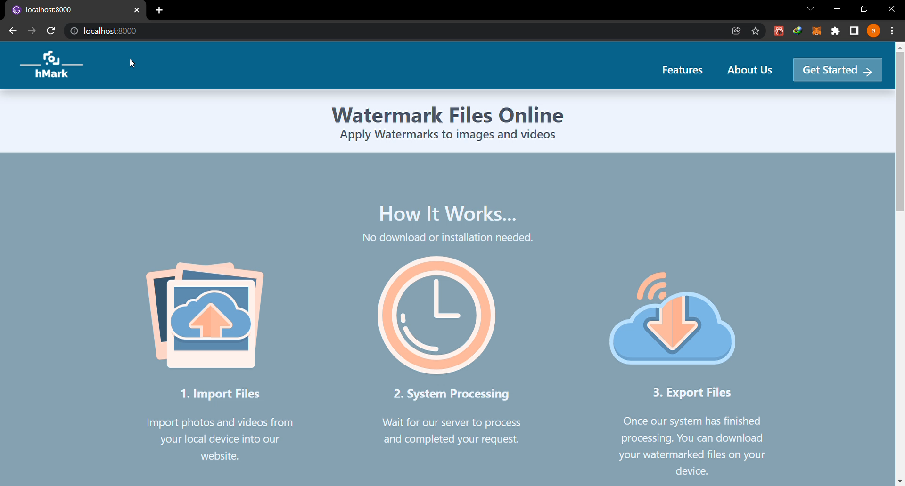
GUI (Full Screen)

Slide 11
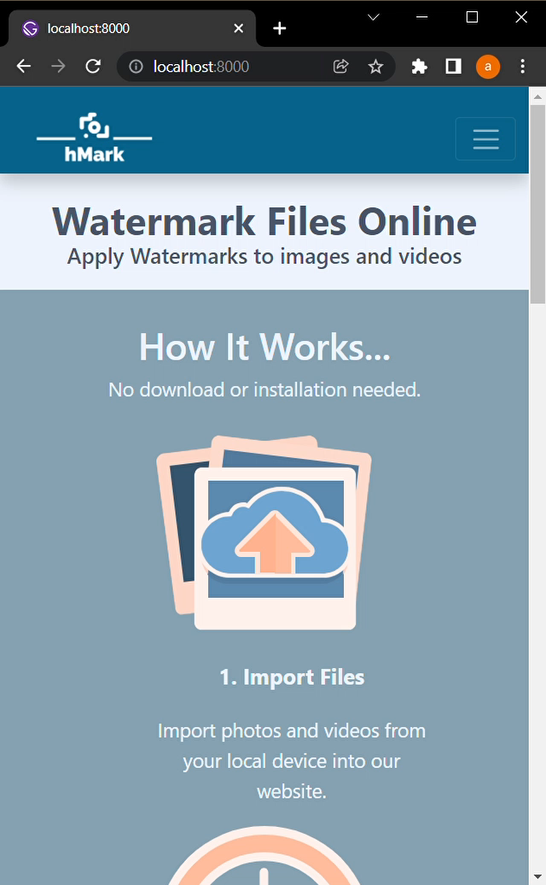
GUI (Small Screen)

Slide 12
Code Explanation Triple Recovery Method
Lookup table
Image size
Block number
Watermark process
Authentication process

Slide 13
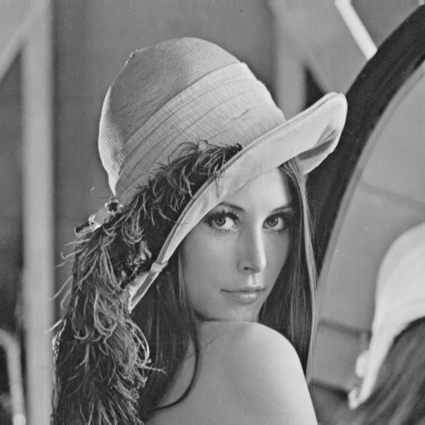

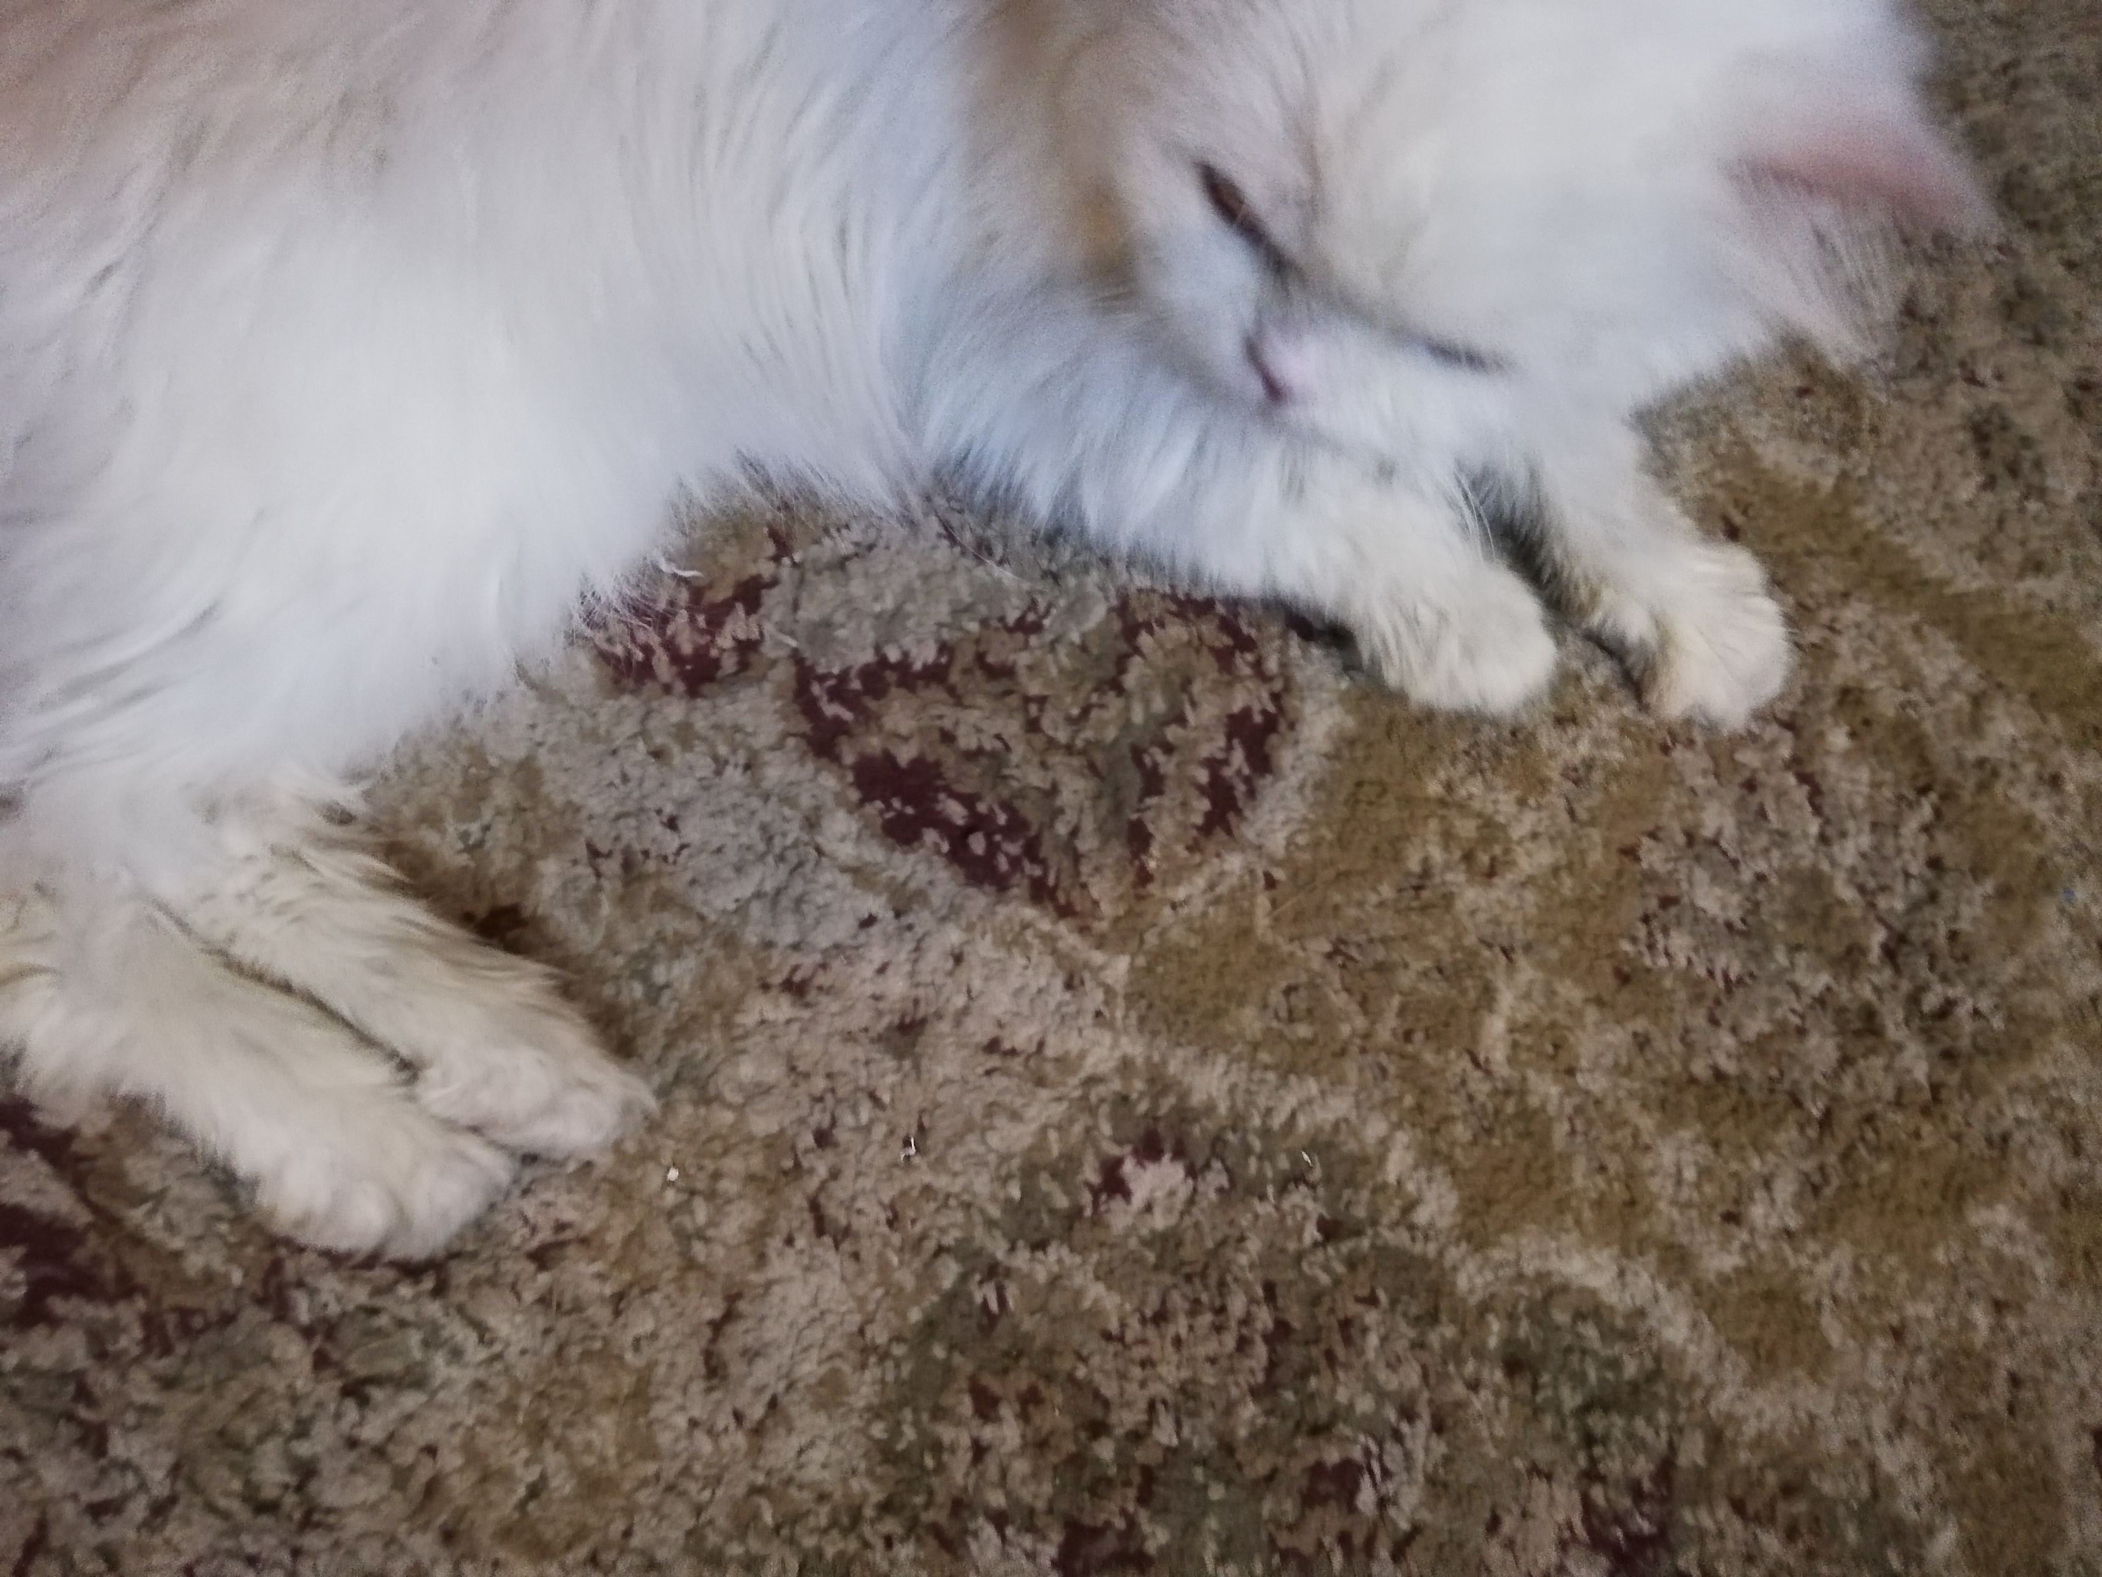
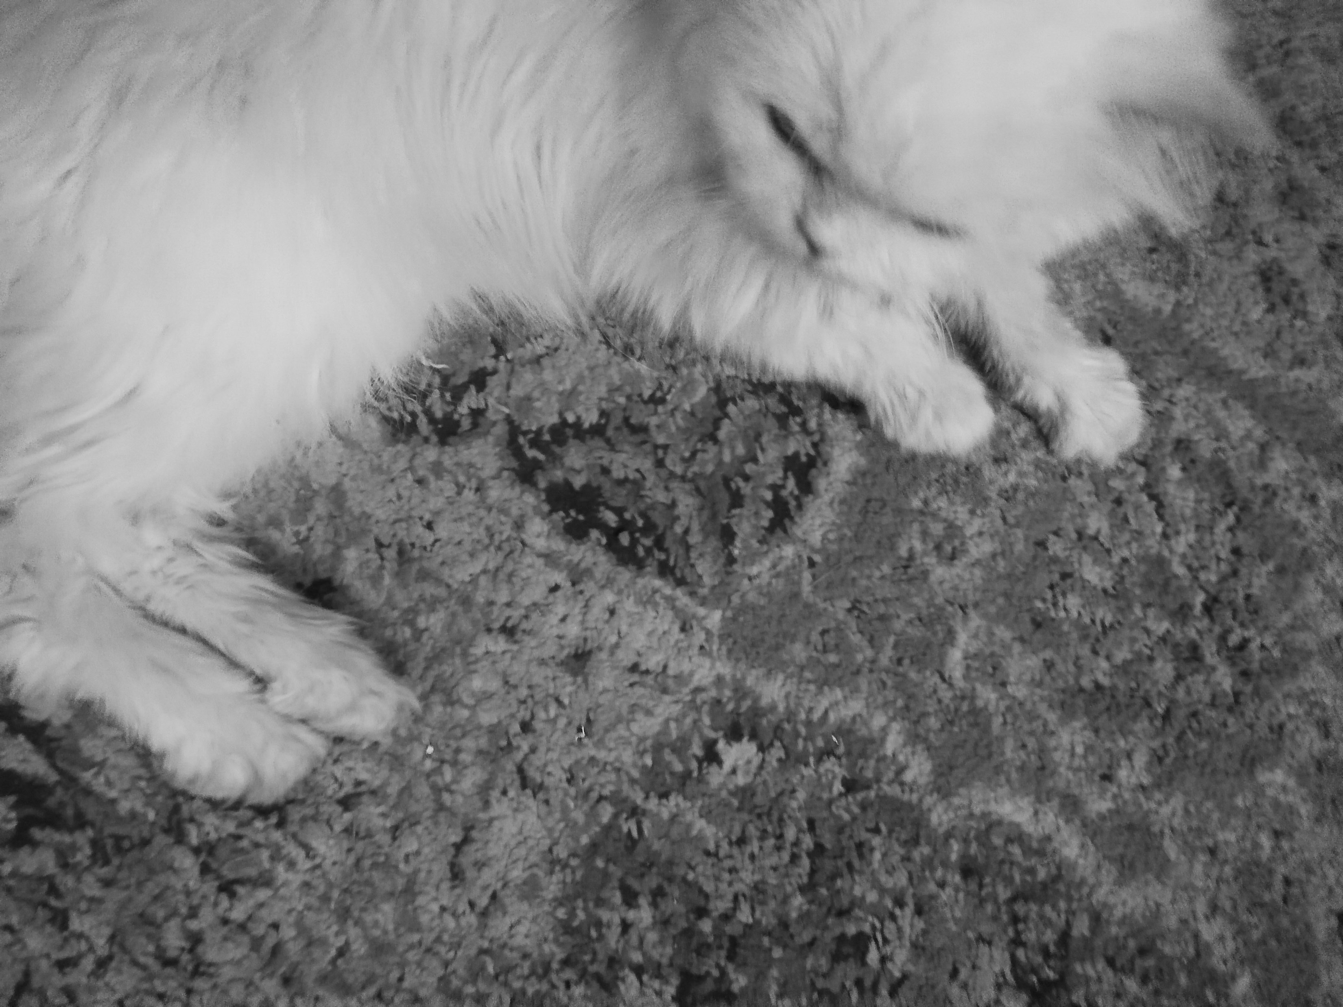
Prototype Results (Triple Recovery Method)
Original Image | Watermarked Image | Execution Time (Seconds) | PSNR (Watermarked Image)
 |  | 10 | 50.09
 |  | 45 | 50.10

Slide 14


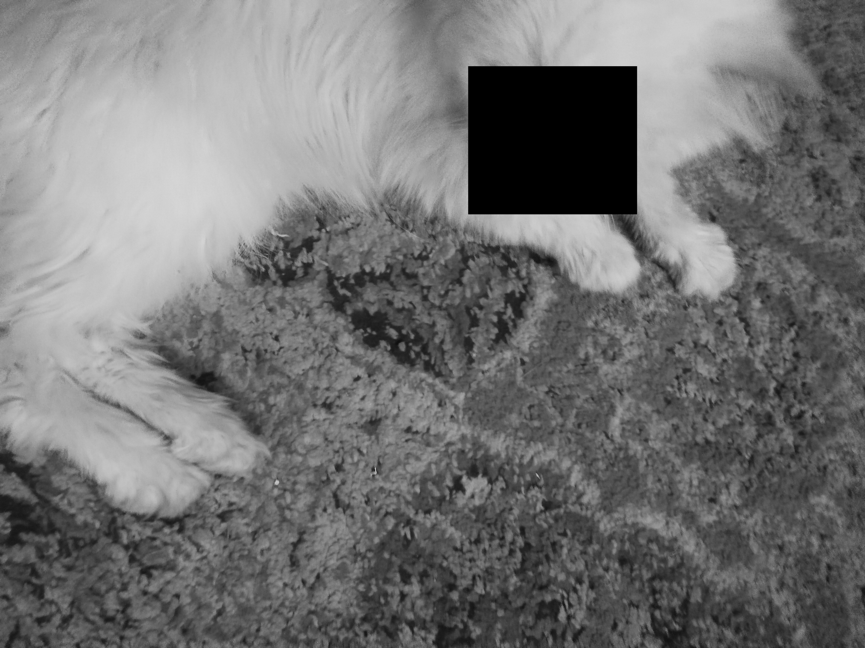

Prototype Results (Triple Recovery Method)
Tampered Image | Output Image

Slide 15
Code Explanation Pixel-wise Method
Block division
Bit sequence generation and permutation of bit sequence using user key
Watermark embedding
Authentication module

Slide 16


Prototype Results (Pixel-wise Method)
Original Image | Watermarked Image | Execution Time (Seconds) | PSNR (Watermarked Image)
 |  | 2.33 | 38.38
 |  | 147.18 | 38.35

Slide 17
Future Plan
Finalize image restoration module.
Compare total results of both research papers.
Completed keyframe extraction module and frame index embedding module.
Extend the method with better results to support video authentication and recovery.
Backend connectivity with frontend.

Slide 18
References
Gul, E., Ozturk, S. A novel triple recovery information embedding approach for self-embedded digital image watermarking. Multimed Tools Appl 79, 31239–31264 (2020). https://doi.org/10.1007/s11042-020-09548-4
Gul, E., Ozturk, S. A novel pixel-wise authentication-based self-embedding fragile watermarking method. Multimedia Systems 27, 531–545 (2021). https://doi.org/10.1007/s00530-021-00751-3
Gul, E., Ozturk, S. A novel hash function based fragile watermarking method for image integrity. Multimed Tools Appl 78, 17701–17718 (2019). https://doi.org/10.1007/s11042-018-7084-0
P. Deshmane, "MRKFE: Designing cascaded map reduce algorithm for key frame extraction," 2017 International Conference on Information Communication and Embedded Systems (ICICES), 2017, pp. 1-6, doi: 10.1109/ICICES.2017.8070719

Slide 19
Thank You
18L-0756 Arbab Hamd Rizwan
18L-0972 Usama Aslam
18L-1131 Aashar Naseem
18L-1139 Hunzlah Malik

